Slide 1
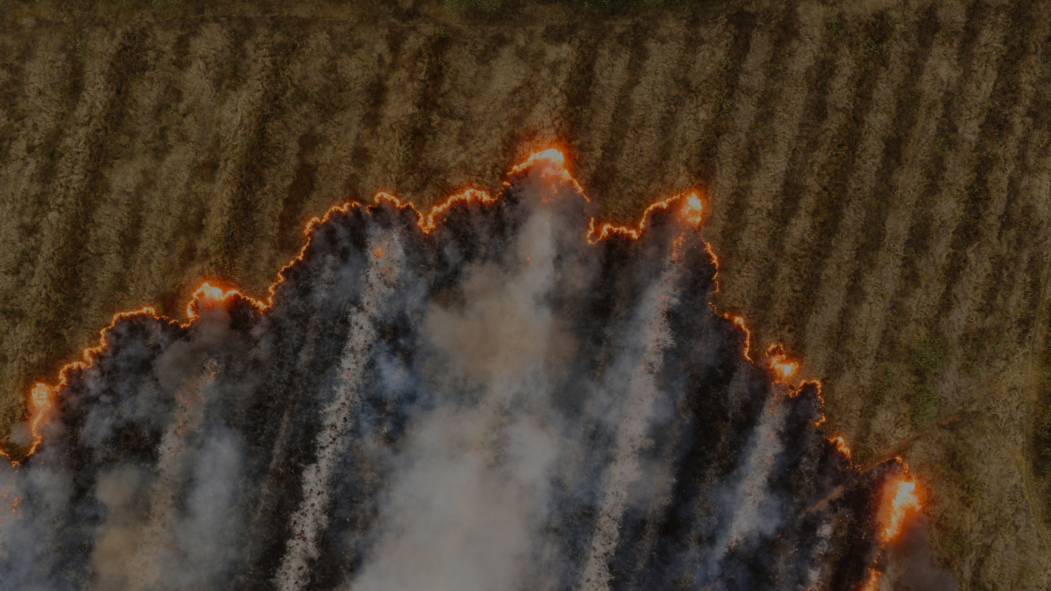
GEOSPATIAL MACHINE LEARNING PLATFORM FOR WILDFIRE RISK ASSESSMent and Crop Health Monitoring
PROJECT BY
AKHIL KANUKULA (SL54772)
SANJAY VARATHARAJAN (UL66332)

Slide 2
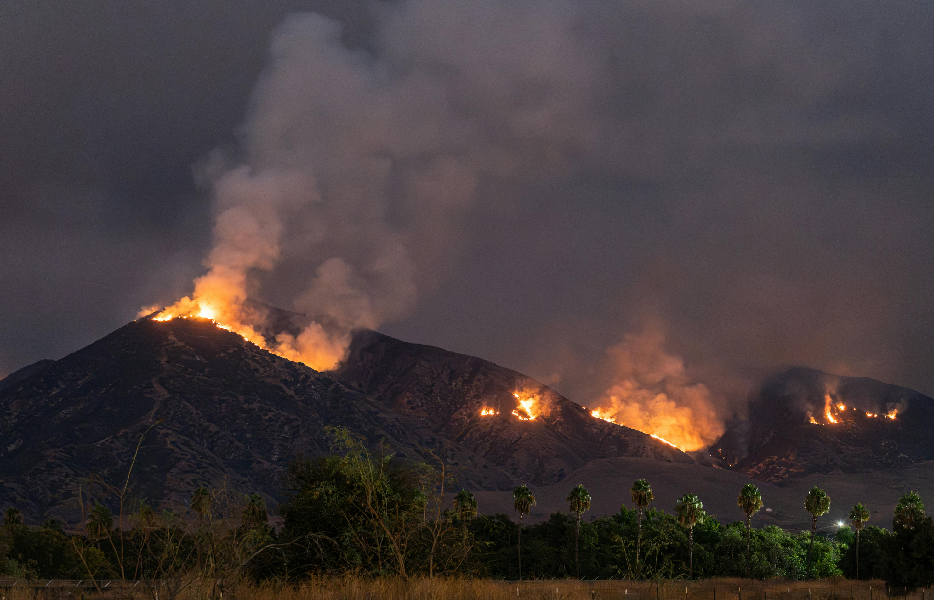
ULTIMATE BUSINESS PROBLEM
Wildfires and crop failures pose substantial risks to lives, livelihoods, ecosystems, and national food security. For wildfires, utilities, insurers, and emergency managers need risk maps to prioritize vegetation management, pre-stage resources, and price risk. For agriculture, growers, agribusinesses, and governments need near–real-time crop health monitoring to manage inputs, hedge production risk, and mitigate food insecurity.
An AI-driven geospatial platform can transform raw satellite data into operational insights at regional to national scale. This project builds such a platform, combining remote sensing, time-series ML, and a web application to deliver wildfire risk layers, burned area maps, crop stress maps, and yield proxies.

Slide 3
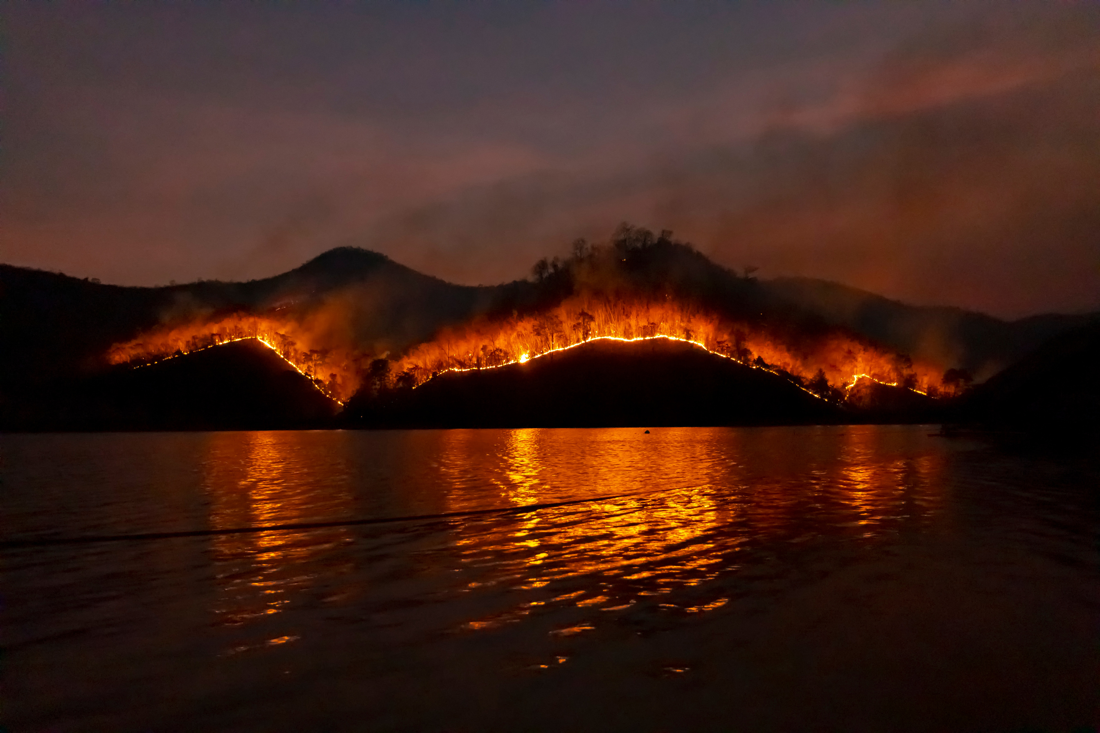
DATA SOURCES
Sentinel‑2 Surface Reflectance (10 m, multispectral) — input imagery (RGB, NIR, red‑edge): Copernicus Open Access / Google Earth Engine (GEE).
MODIS Burned Area (MCD64A1, 500 m, monthly) — ground truth for burned area segmentation; available on GEE
NASA FIRMS (MODIS/VIIRS active fire points) — near real‑time fire detections for feature engineering and validation.
USDA Cropland Data Layer (CDL, 30 m, annual, USA) — crop type labels and agricultural mask; available on GEE.
SRTM DEM (30 m) — elevation-derived slope/aspect for fire spread risk.
Weather/Reanalysis — e.g., ERA5 temperature, humidity, wind for risk features.
Double click to get hyperlinks of data sources used for the project

Slide 4

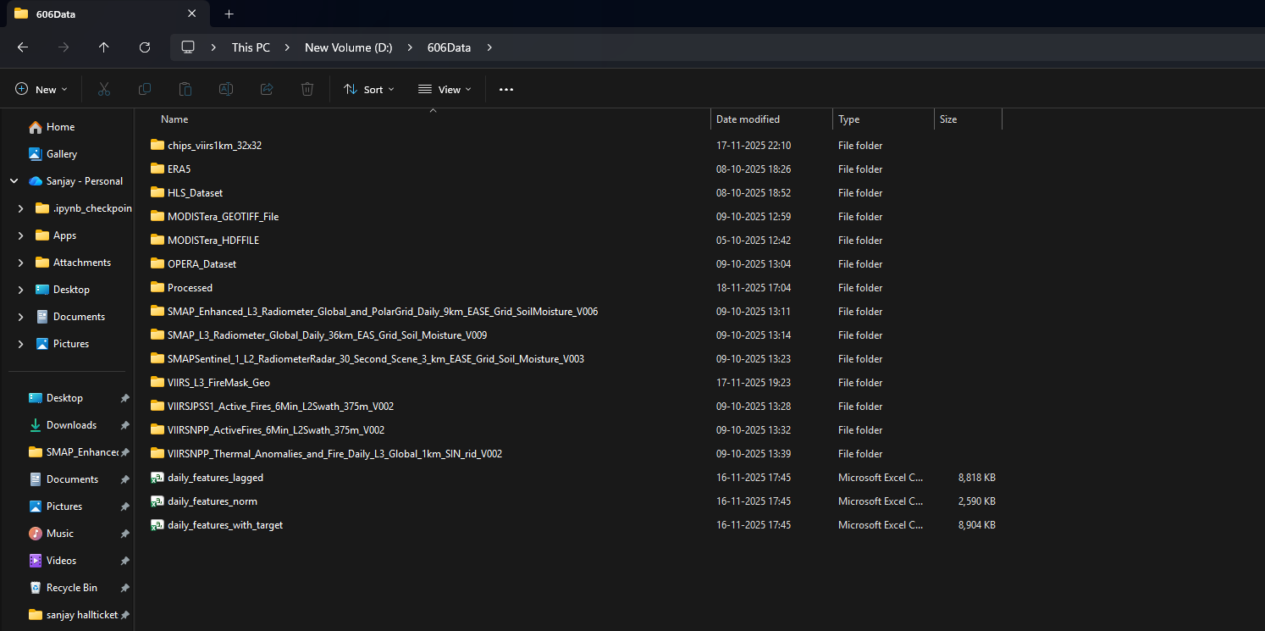
DATA SOURCES IN LOCAL

Slide 5
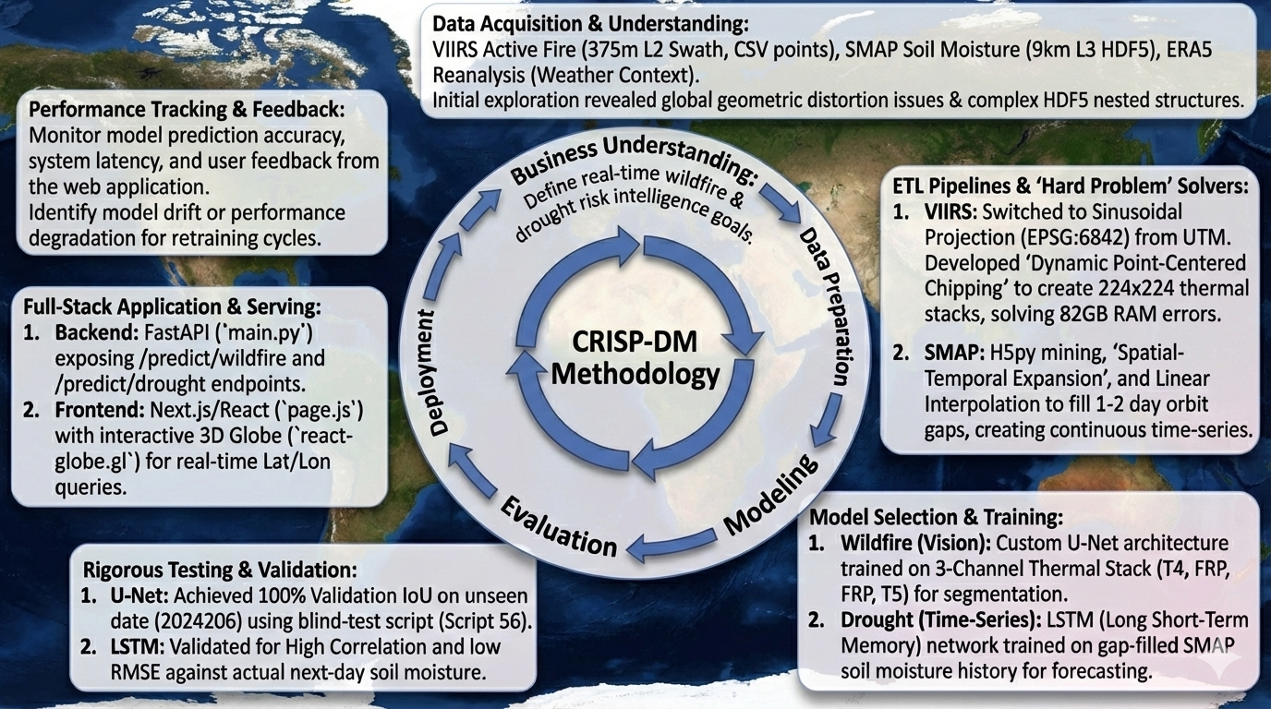

Slide 6
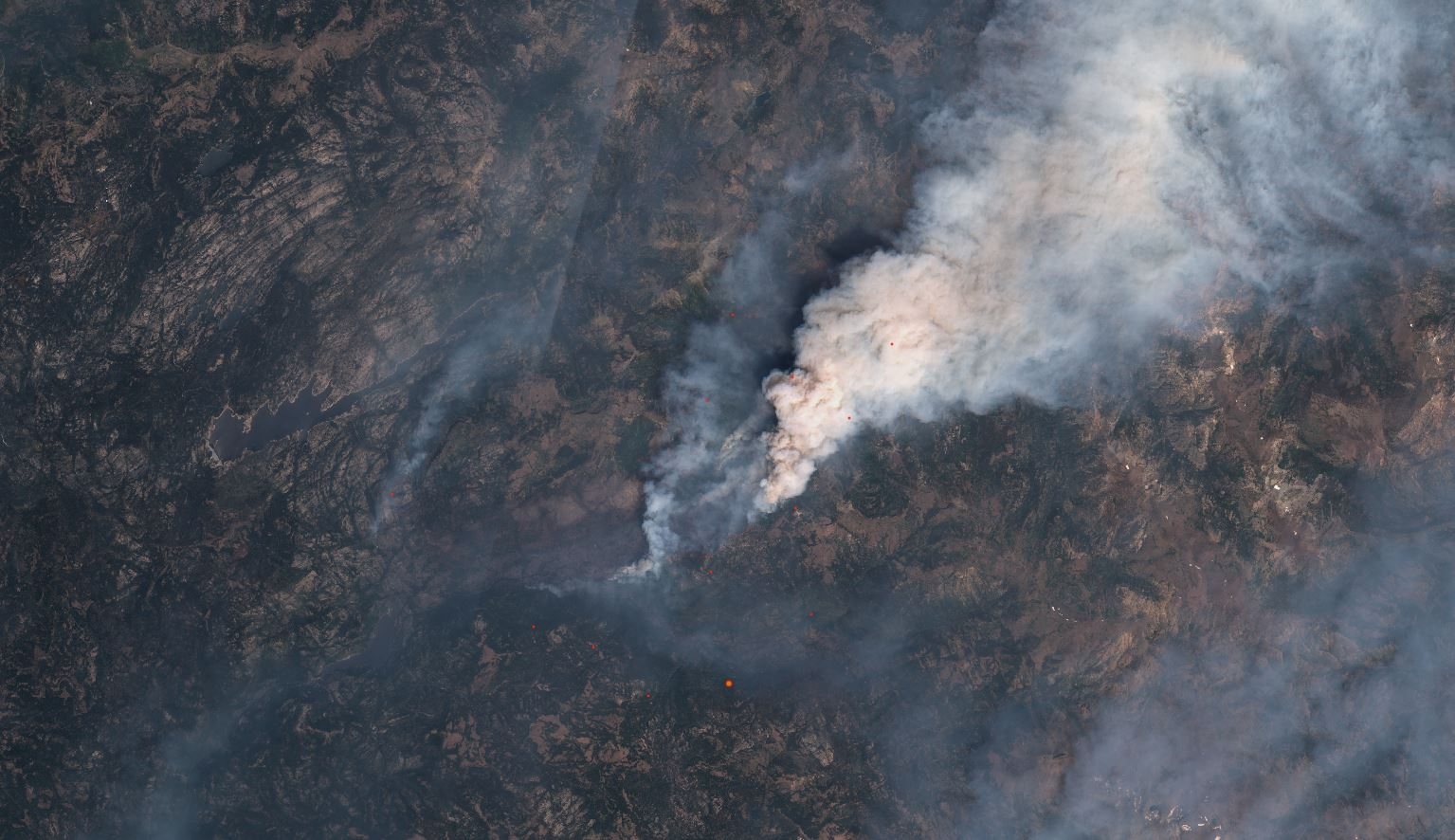
MODELLING APPROACH
Ingest VIIRS (Thermal) and SMAP (Soil Moisture) raw data
Apply Sinusoidal Projection (EPSG:6842) to fix geometric distortion
Execute Dynamic Point-Centered Chipping (224x224 extraction)
Normalize 3-Channel Thermal Stacks (0-1 Scaling)
Apply Linear Interpolation to fill temporal orbit gaps
Split Data into Training (80%), Validation (20%), Testing sets
Define Hyperparameters (Learning Rate=1e-4, Batch Size=16)
Initialize Custom U-Net Architecture (Encoder-Decoder)
Initialize LSTM Architecture (Sequential Memory)
Define Loss Functions (BCEWithLogits for Fire, MSE for Crop)
Prepare PyTorch Datasets and Dataloaders (with shuffling)
Execute Training Loop
Calculate Metrics: IoU (Segmentation) and Correlation (Forecasting)
Implement Early Stopping to prevent overfitting
Save Best Model Weights (.pth) for Deployment

Slide 7

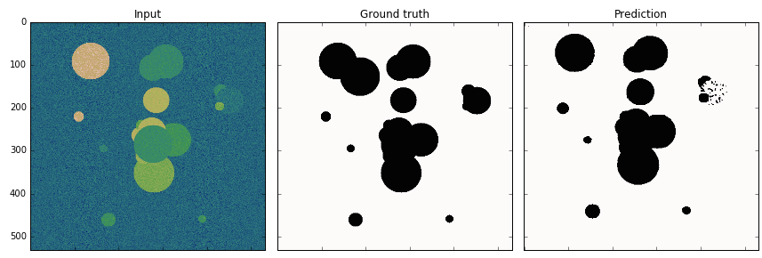
CORE ARCHITECTURES - U-NET
Our Geospatial Machine Learning Platform employs two distinct deep learning paradigms to handle multi-modal satellite data. Fundamentally, the U-Net (for Wildfire) works as a spatial autoencoder, compressing thermal input to capture context ("encoding") and then reconstructing it to generate a precise segmentation mask ("decoding").

Slide 8

https://lmb.informatik.uni-freiburg.de/people/ronneber/u-net/?ref=assemblyai.com
ARCHITECTURE (EXAMPLE FOR 32X32 PIXELS IN THE LOWEST RESOLUTION). EACH BLUE BOX CORRESPONDS TO A MULTI-CHANNEL FEATURE MAP. THE NUMBER OF CHANNELS IS DENOTED ON TOP OF THE BOX. THE X-Y-SIZE IS PROVIDED AT THE LOWER LEFT EDGE OF THE BOX. WHITE BOXES REPRESENT COPIED FEATURE MAPS. THE ARROWS DENOTE THE DIFFERENT OPERATIONS.

Slide 9
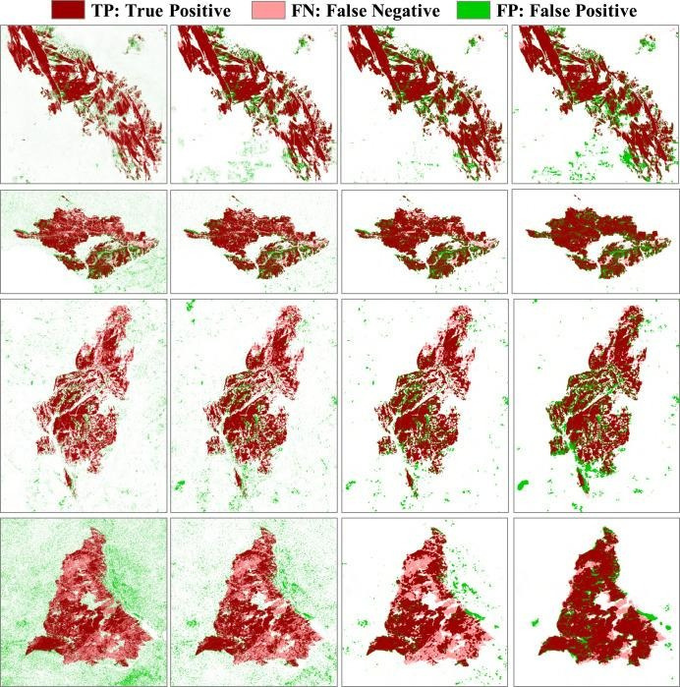
CORE ARCHITECTURES - U-NET

Slide 10



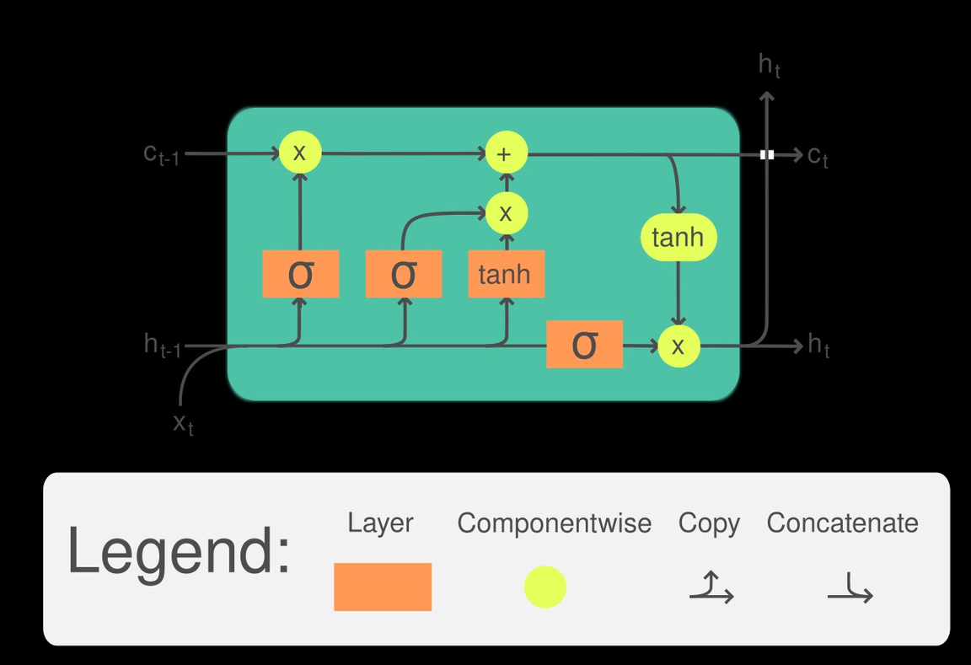
THINK
UNLIMITED
CORE ARCHITECTURES - LSTM
LSTM (for Crops) is a Recurrent Neural Network that works by preserving a "memory" of past soil moisture conditions, allowing it to learn long-term temporal dependencies and predict future stress events from historical sequences.

Slide 11
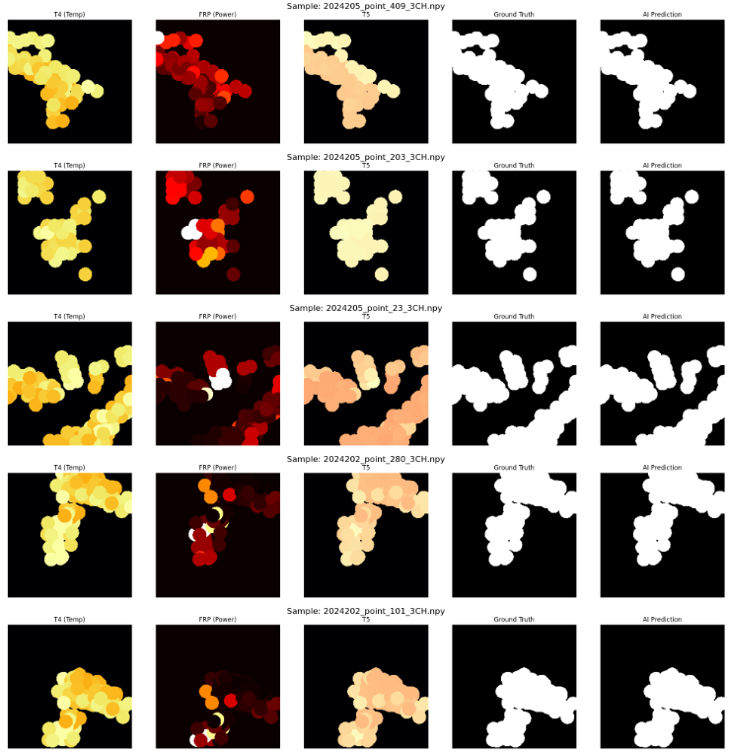
THE PREDICTED FIRE MASKS OF SAMPLE THERMAL CHIPS GENERATED WITH THE MODEL WE CREATED

Slide 12
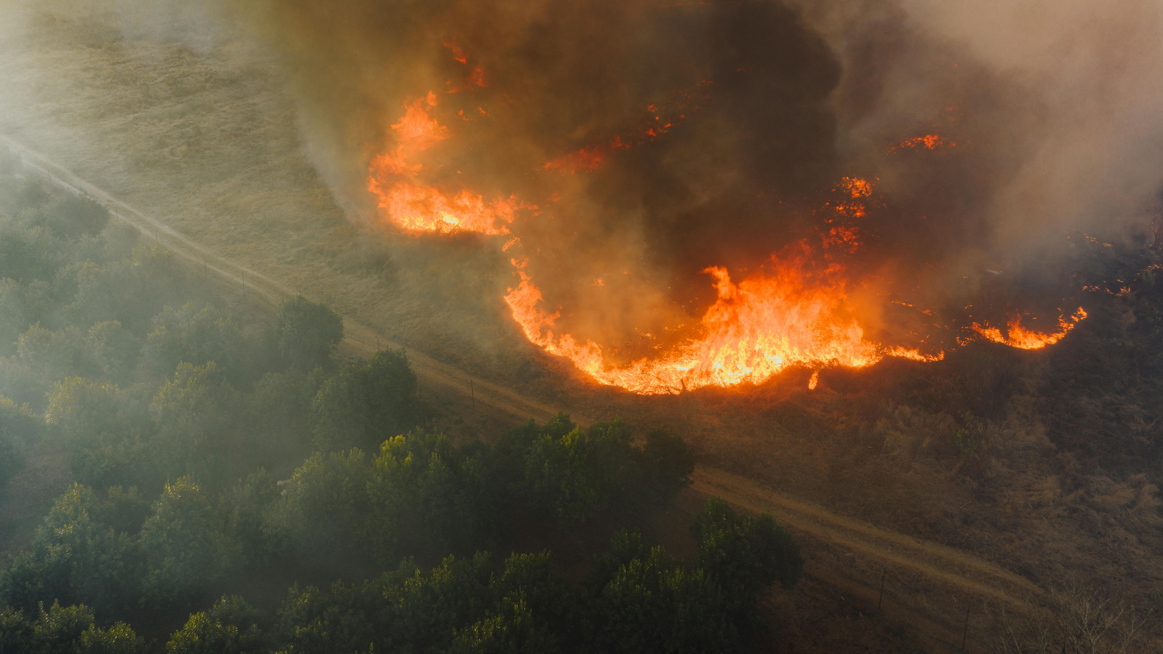
WHY U-NET & LSTM ?
Standard CNN Classifiers (ResNet/VGG) (Rejected because they only give a label like "Fire" or "No Fire," but cannot tell you the exact shape or location.)
Object Detection (YOLO / Faster R-CNN) (Rejected because bounding boxes are too coarse. Fires have irregular, jagged shapes that boxes cannot capture accurately.)
Traditional ML (Random Forest / SVM) (Rejected because they treat pixels independently and lose the critical spatial context (neighbors) and temporal history.)
Statistical Models (ARIMA / Linear Regression) (Rejected for drought forecasting because soil moisture has complex, non-linear patterns that simple linear models fail to capture.)
Vision Transformers (ViT) (Considered, but U-Net is more computationally efficient for pixel-level segmentation on our specific chip size.)

Slide 13
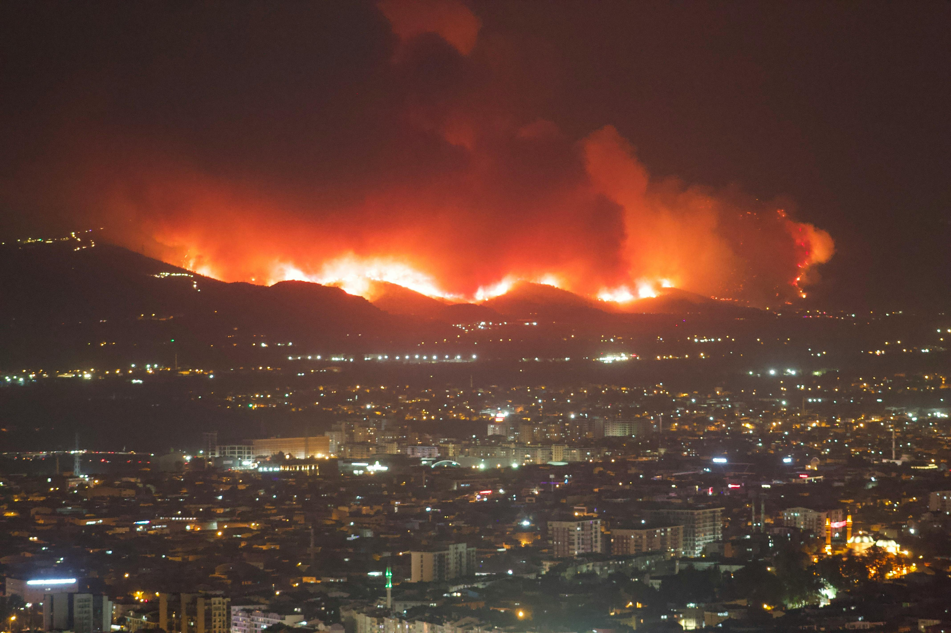
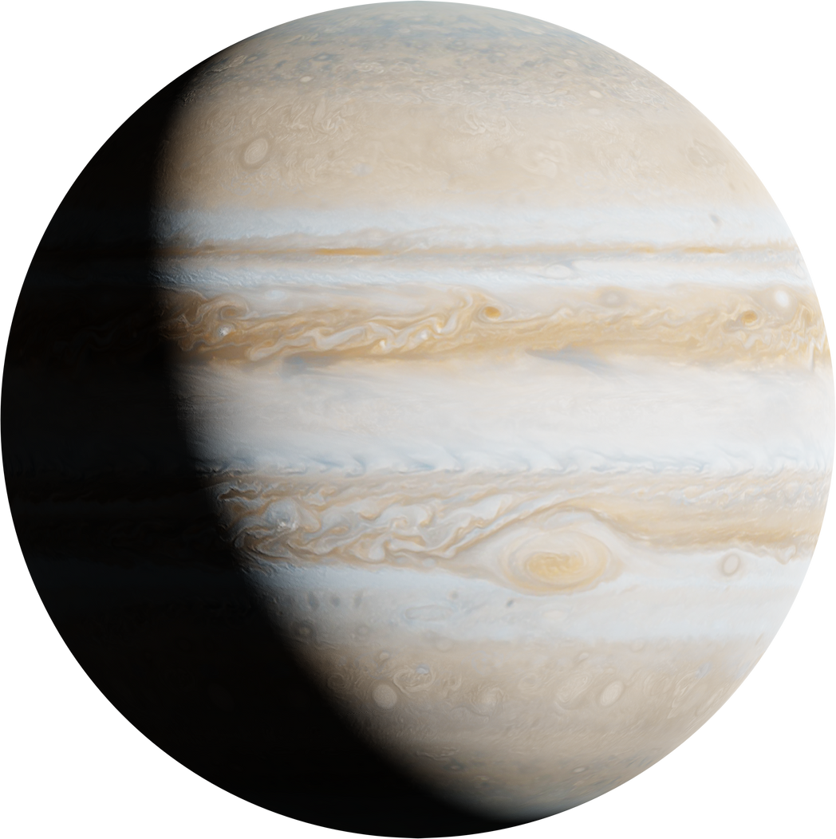
THINK
UNLIMITED
CHALLENGES
GEOMETRIC PROJECTION INCOMPATIBILITY (DEALING WITH THE MISMATCH BETWEEN VIIRS SINUSOIDAL DATA AND STANDARD UTM GRIDS.)
EXTREME MEMORY OVERHEAD (82GB RAM SPIKES) (THE CRASH WE FACED WHEN TRYING TO RASTERIZE GLOBAL DATA ONTO A STATIC GRID.
COMPLEX HDF5 DATA STRUCTURES (THE DIFFICULTY OF MINING NESTED DATA LAYERS FROM SMAP SCIENTIFIC FILES USING STANDARD LIBRARIES.)
SPATIO-TEMPORAL DISCONTINUITY (THE CHALLENGE OF TRAINING TIME-SERIES MODELS ON SATELLITE DATA THAT HAS NATURALLY OCCURRING 1-2 DAY ORBIT GAPS.)
NITIAL ATTEMPTS TO MAP GLOBAL VIIRS DATA TO A STANDARD GRID CAUSED MASSIVE SYSTEM CRASHES, FORCING A COMPLETE RE-ENGINEERING OF THE PIPELINE INTO A "DYNAMIC CHIPPING" ARCHITECTURE.

Slide 14
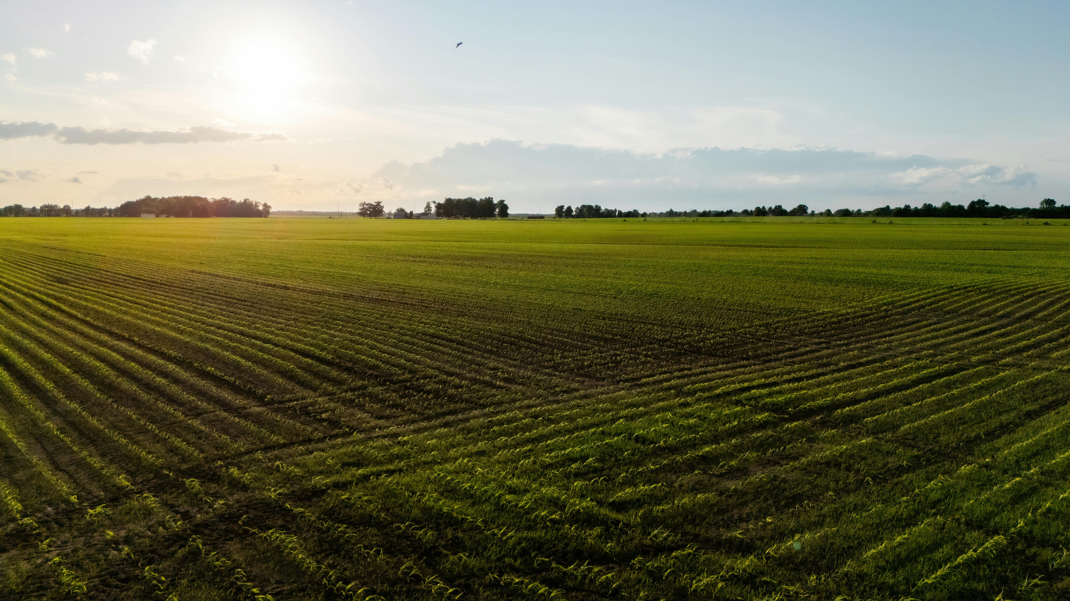
THINK
UNLIMITED
THE PROMISE
Scalability:
Deploying this pipeline on distributed cloud architectures (like AWS Lambda or Google Earth Engine) enables the real-time processing of petabyte-scale global datasets.
This platform can be extended to incorporate Harmonized Landsat-Sentinel (HLS) data, evolving the current regional drought forecasts into hyper-local "Precision Agriculture" insights at the individual field level (10m resolution).
This approach empowers environmental analysts and governments to simulate future food security scenarios, predicting crop yields and harvest failures months in advance.

Slide 15
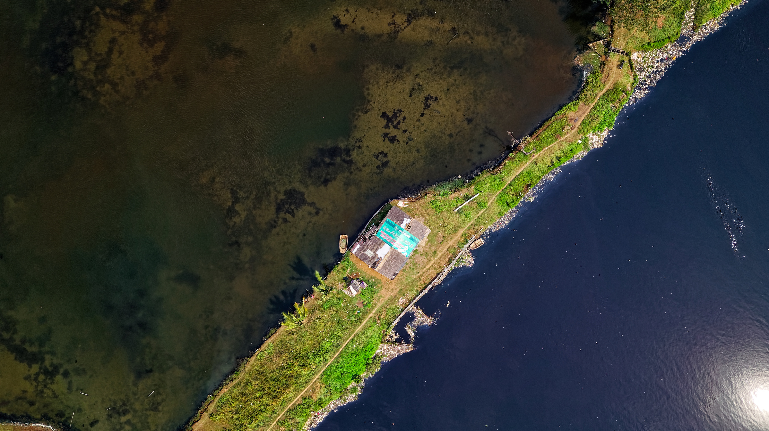
THINK
UNLIMITED
REFERENCES:
1. Ronneberger, O., Fischer, P., Brox, T. (2015). U-Net: Convolutional Networks for
Biomedical Image Segmentation. In: Navab, N., Hornegger, J., Wells, W., Frangi, A.
(eds) Medical Image Computing and Computer-Assisted Intervention – MICCAI 2015.
MICCAI 2015. Lecture Notes in Computer Science(), vol 9351. Springer, Cham.
https://doi.org/10.1007/978-3-319-24574-4_28
2. Hochreiter S, Schmidhuber J. Long short-term memory. Neural Comput. 1997 Nov
15;9(8):1735-80. https://doi.org/10.1162/neco.1997.9.8.1735 PMID: 9377276.
3. Schroeder, W., Oliva, P., Giglio, L., & Csiszar, I. (2014). The New VIIRS 375 m active fire
detection data product: Algorithm description and initial assessment. Remote
Sensing of Environment, 143, 85-96.
https://api.semanticscholar.org/CorpusID:17180349
4. D. Entekhabi et al., "The Soil Moisture Active Passive (SMAP) Mission," in Proceedings
of the IEEE, vol. 98, no. 5, pp. 704-716, May 2010, doi: 10.1109/JPROC.2010.2043918
https://ieeexplore.ieee.org/document/5460980
5. Kingma, D. P., & Ba, J. (2014). Adam: A Method for Stochastic Optimization. arXiv
preprint arXiv:1412.6980. The source for the adaptive learning rate optimization
algorithm used to train our U-Net model
https://arxiv.org/abs/1412.6980

Slide 16

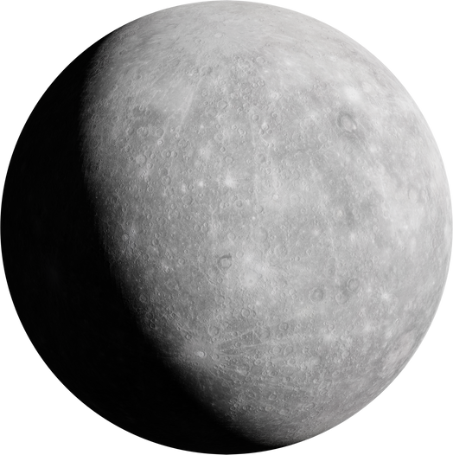
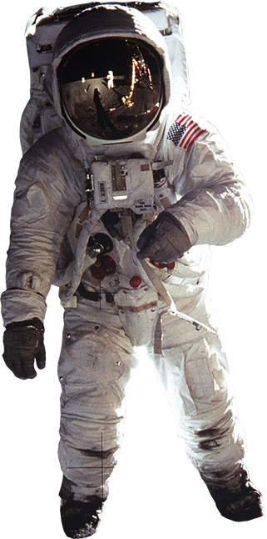
THINK
UNLIMITED
THANK YOU

